Slide 1
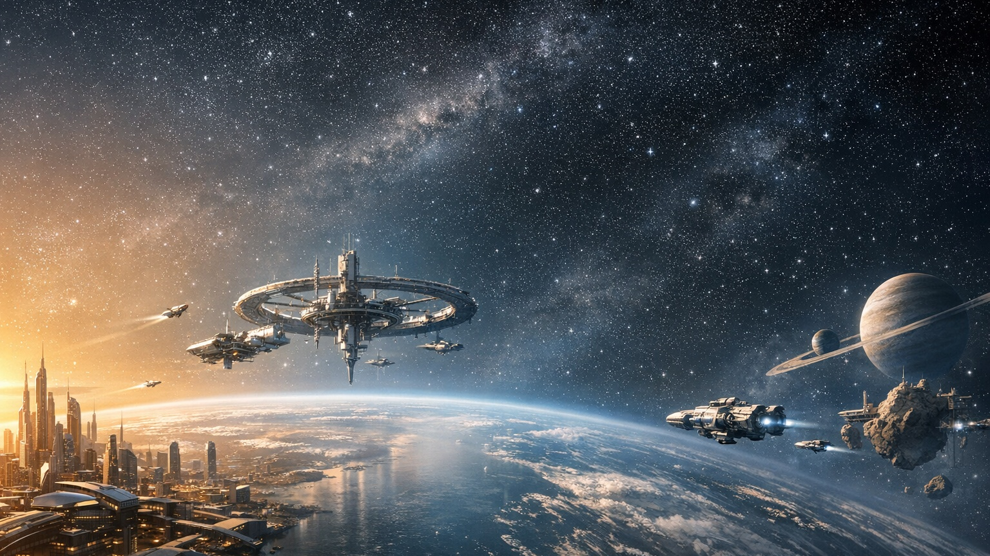
FUTURE SYSTEMS BRIEFING
Possible Futures
A visual sprint from compute abundance to virtual universes.

Slide 2
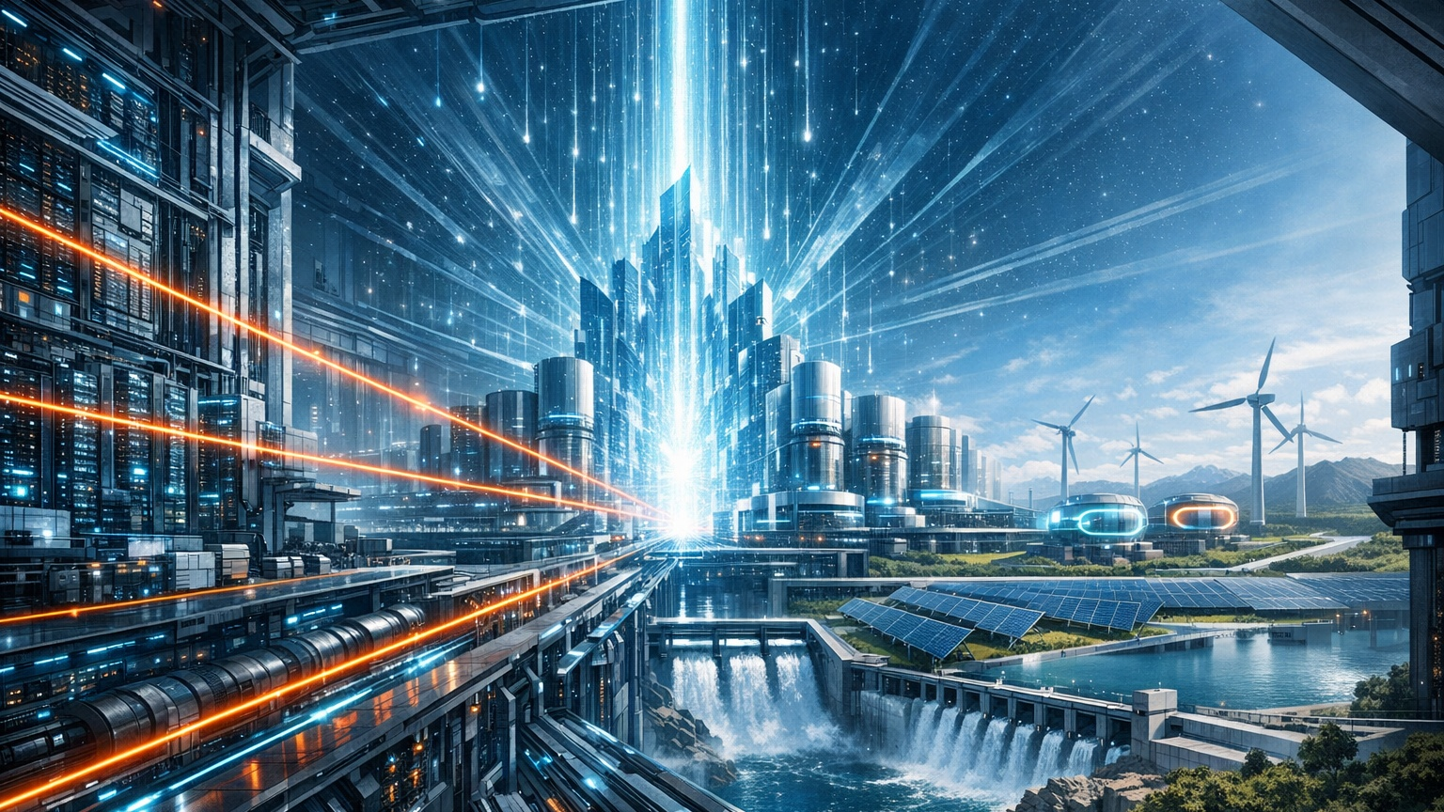
COMPUTE
Massive Compute
Cheaper compute gives small teams super-lab capability.

Slide 3
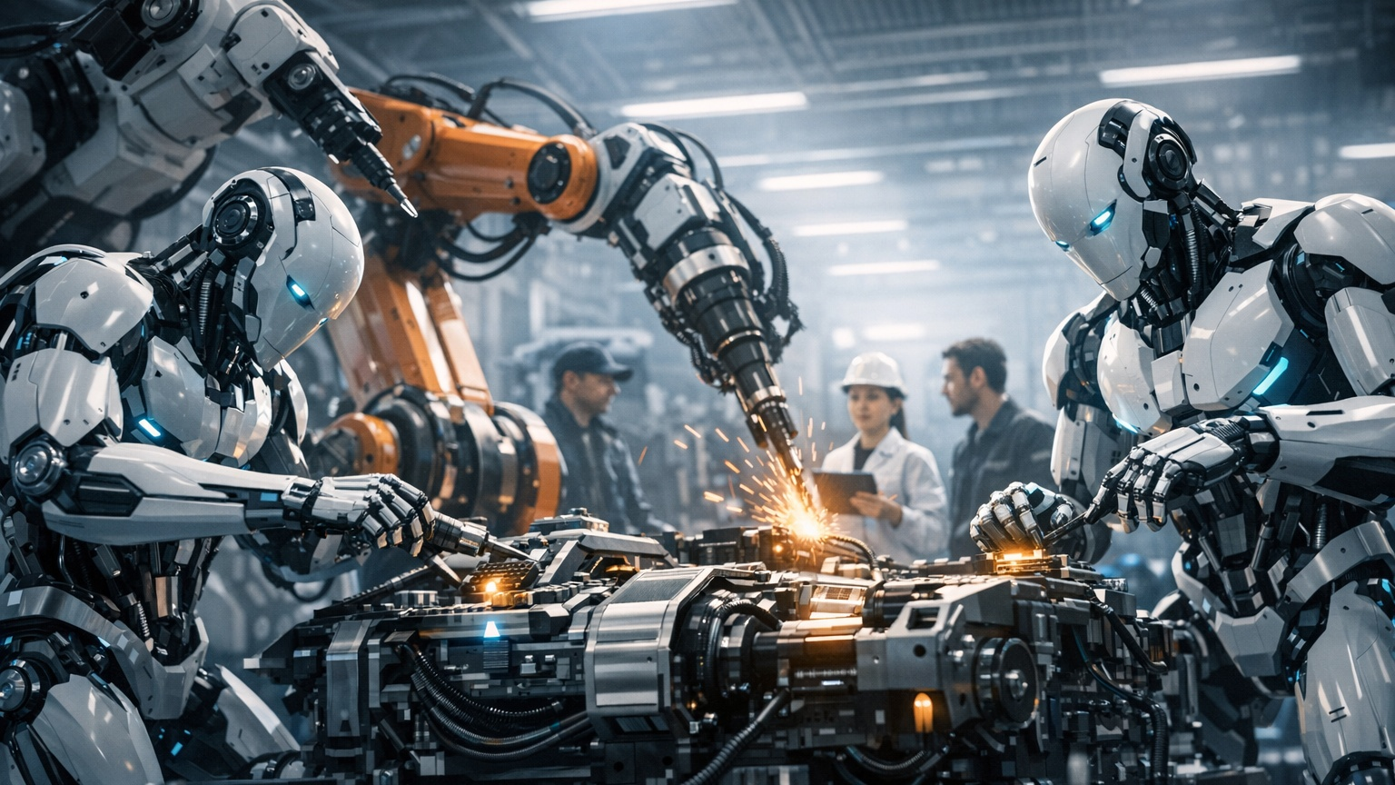
AUTOMATION
Robots Go Mainstream
General-purpose robots become visible workers across real environments.

Slide 4

LONGEVITY
Healthy Lifespan Engineering
Repair-focused medicine extends healthy years, not just lifespan.

Slide 5

NANOTECHNOLOGY
Atomic Precision Manufacturing
Molecular control unlocks new materials and lower waste.

Slide 6
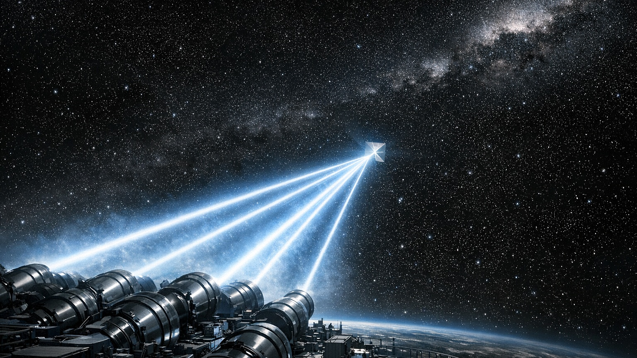
STARSHOT
Energy-Beamed Propulsion
Laser arrays could accelerate ultralight sails toward nearby stars.

Slide 7
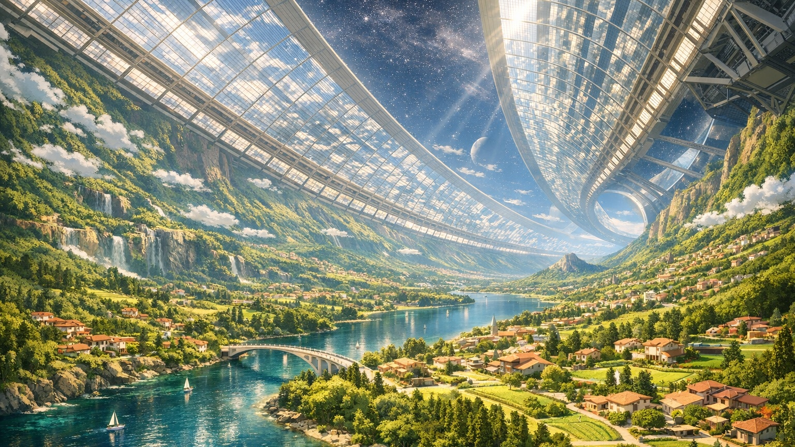
SPACE HABITATS
O'Neill Cylinders
Rotating habitats could support Earth-like living at orbital scale.

Slide 8

INFORMATION
Compression As Intelligence
Compression is not just storage, it is prediction power.

Slide 9

SIMULATION
Virtual Universes
Abundant compute turns possibility space into a new frontier.

Slide 10
CLOSING
Where To Build
The biggest opportunities sit where AI, biotech, robotics, and space overlap.

